Slide 1
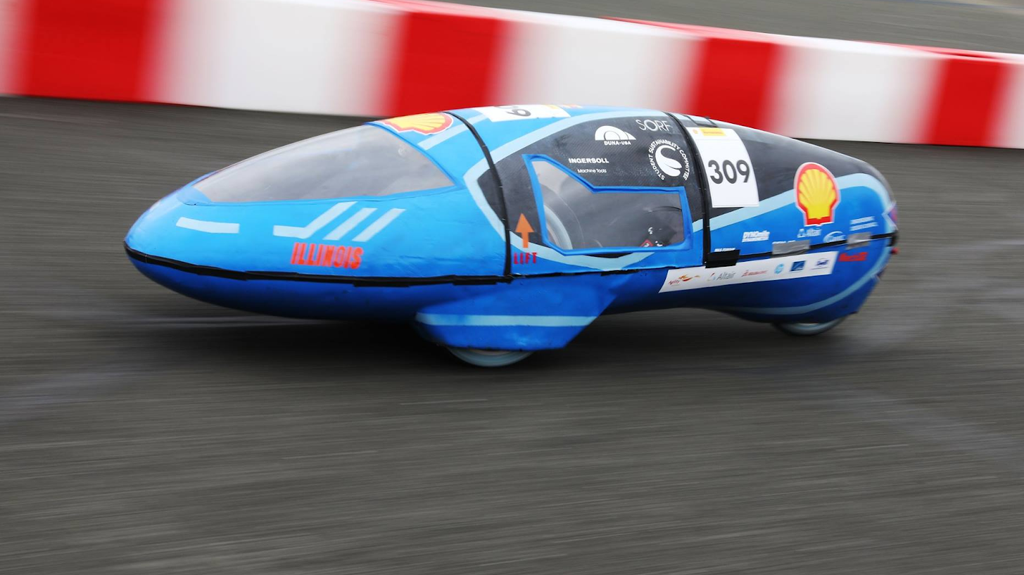

Eco Illini Supermileage
Week:
3/30/2020

Slide 2
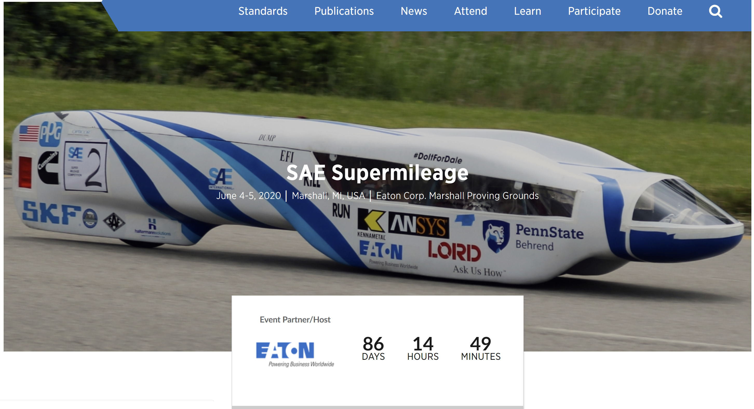
Registration and Administration
Shell 2020
No update yet :(
SAE 2020
Design Report Done
We'll see what comes next
Expect some Skype call discussion?

Slide 3
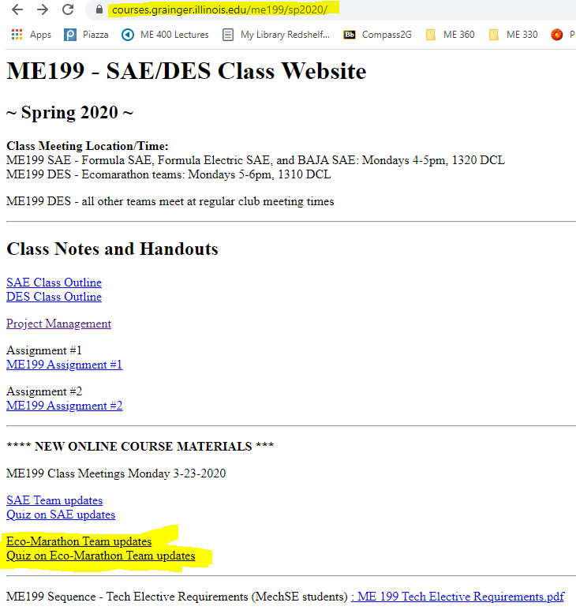
ME 199 and Class Participation
In-class participation suspended
Meetings temporarily on hold
Course Evaluation: (How we will evaluate/give you a grade)
Participation on projects/planning through the rest of SP 2020
Completed CAD Assemblies of projects
Email skamzol2@Illinois.edu for Solidworks
If unable to run, see below
Team Wiki:
Post project work, information/research, methods towards completing your project, and status of project → Why did you do what you did???
List where future development could be made (if any)
Paper: Write conclusion of where project is left at, steps needed to finish it, and rough time needed to assemble/test
Attendance: Take “Quiz”; based on these PPT’s!

Slide 4
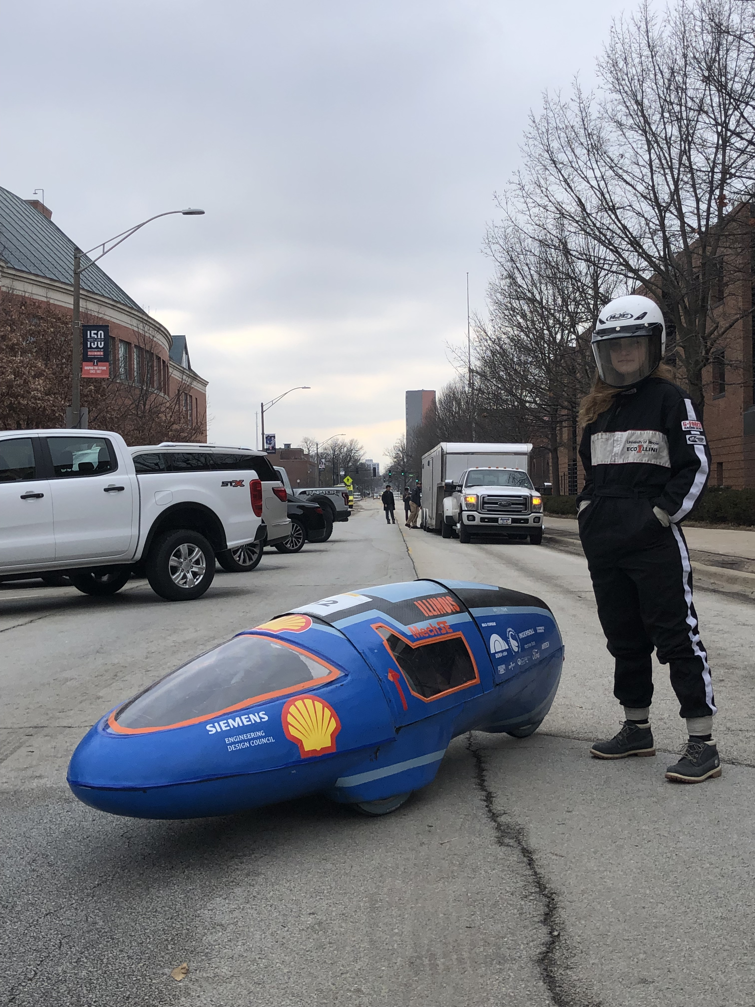
Timeline
Goal for the week:
Define leadership for next year
Wiki: unleash for the masses
Begin Fall 2020 Timeline and critical events
Other Goals:
Have full assemblies with electronics by end of semester
Wiki: Project pages for new members, process diagrams for leads
Quad Day materials and posters: get ready now

Slide 5

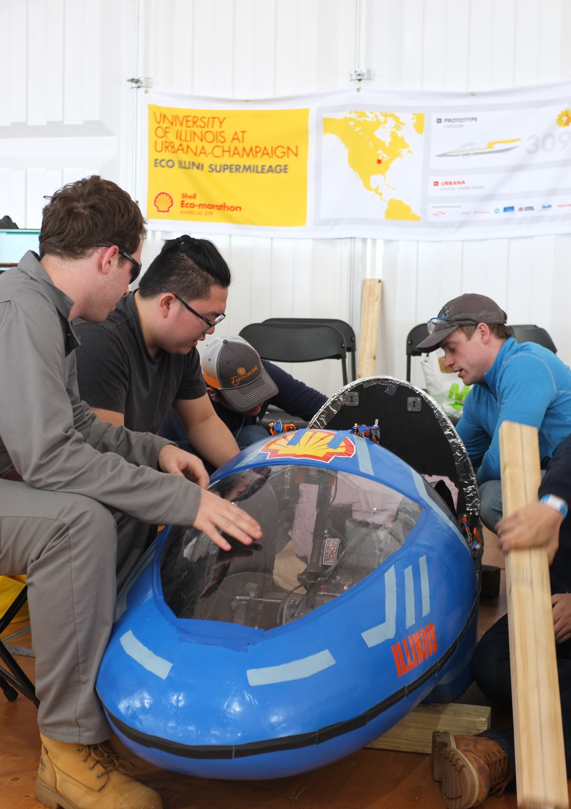
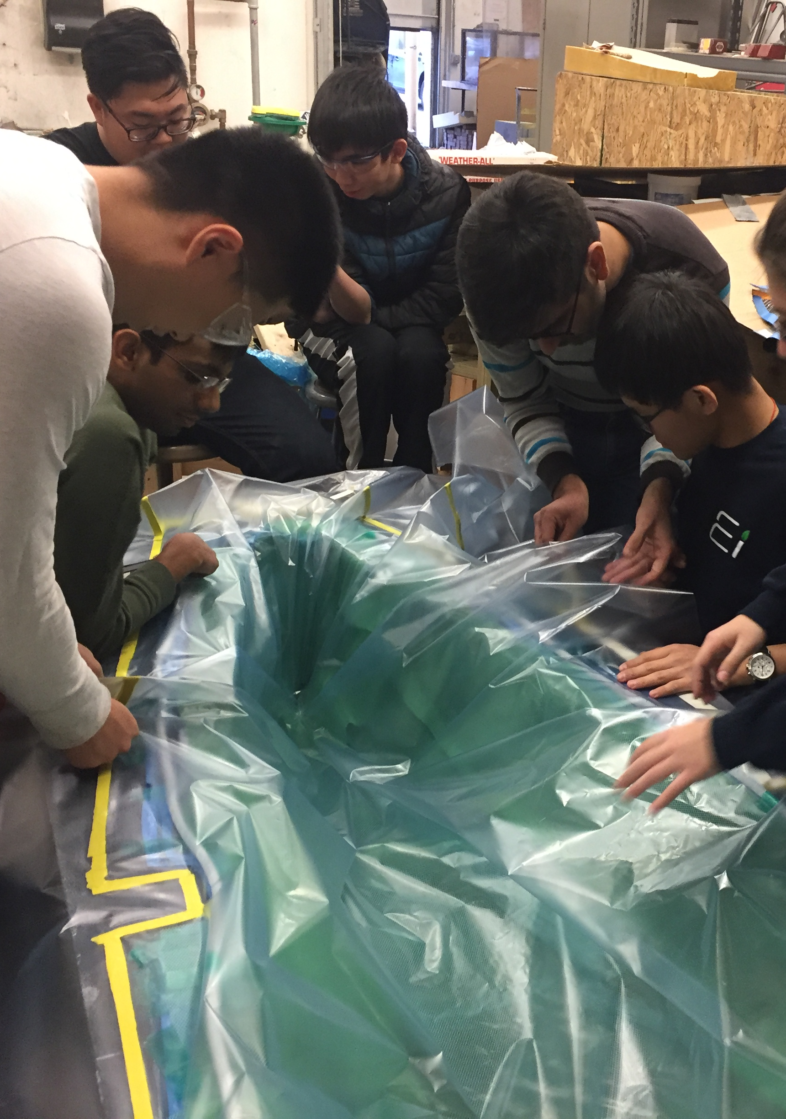
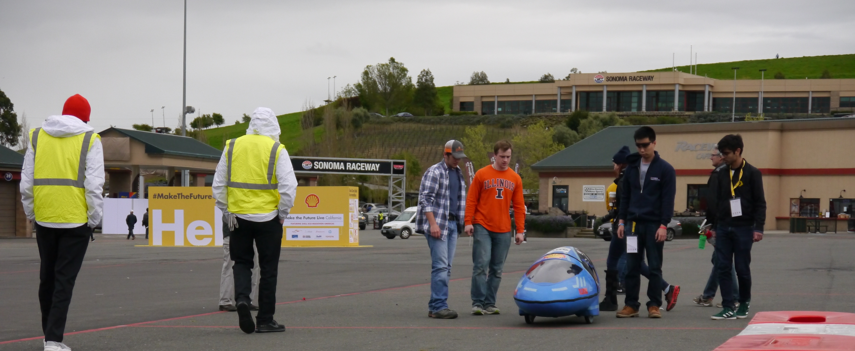
Mechanical

Slide 6
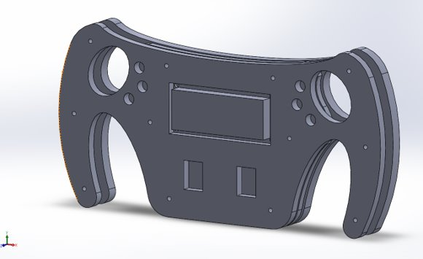
Mechanical
Working on assemblies
Mechanical Subteam arraingement for next year
Goal: Place specialists in charge of different critical subgroups
Workflow plans managed between subsystem and specialist leads
Keep members engaged and provide central contact/chain for development
Structure for 2020-2021
Mechanical Lead
Engine Lead
Brakes/Steering Lead
Testing Lead

Slide 7
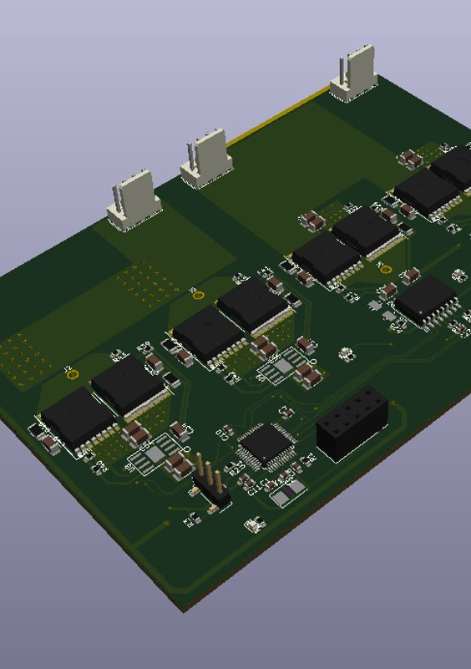
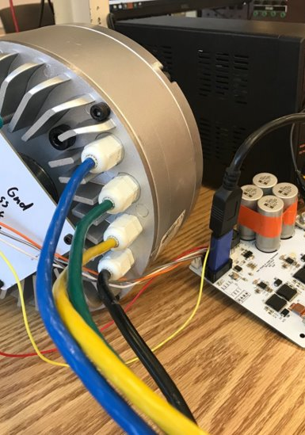
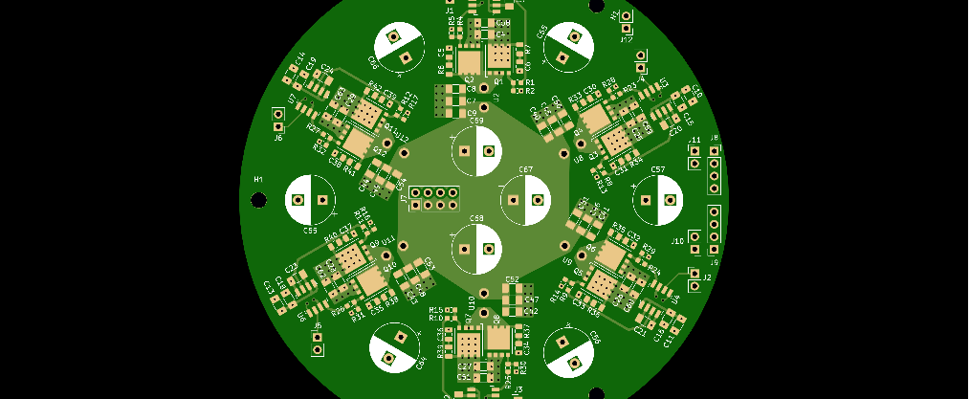
Electrical

Slide 8
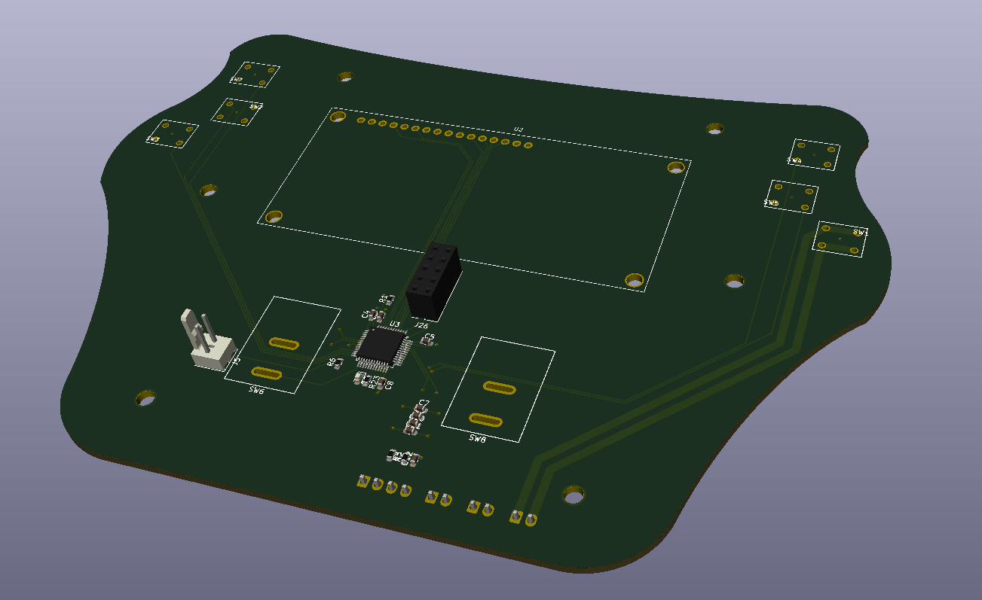
Electrical
Shifting gears from electrical to gas for SAE
Battery manufactured
Steering wheel pcb design
Working on motor mounting issues
Moving back to shelved projects
Alex moves to joint-Eco lead developer
New Electrics subteam lead

Slide 9
Body

Slide 10
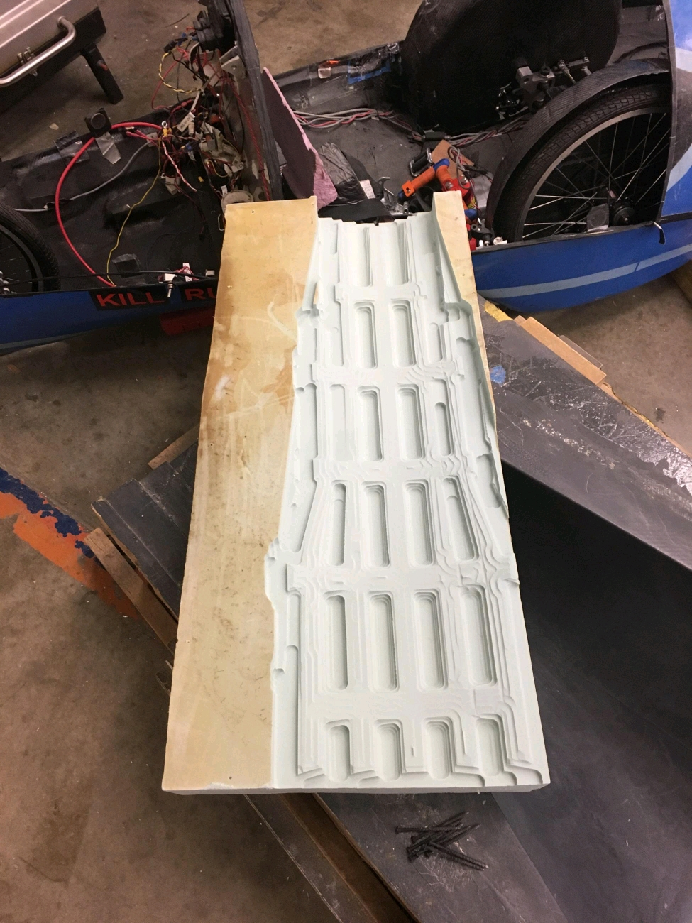
Body Projects
Front truss layup done
Aircore ready for VARTM
1-1.5 weeks away from rolling car pending ESPL opening
Leadership maintains current structure

Slide 11
Aero

Slide 12
Aero Projects
Get Ansys license
Working on Ansys simulations from home, results will be shared!

Slide 13
Manufacturing

Slide 14
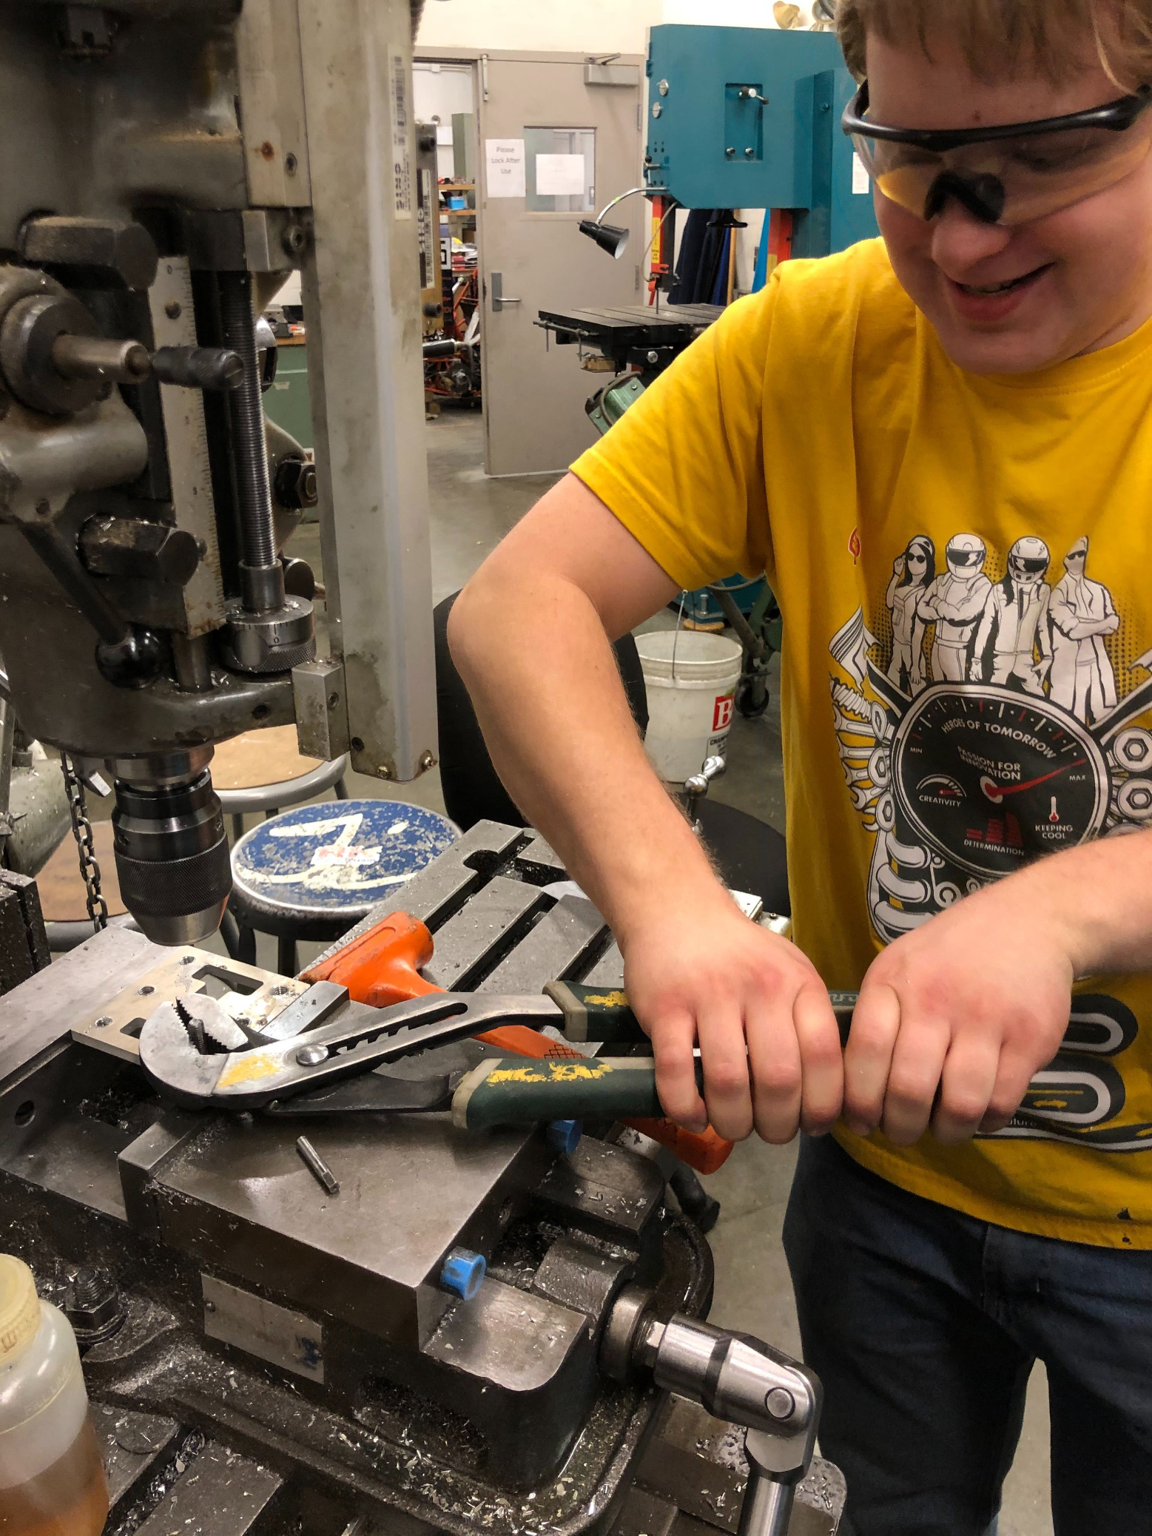
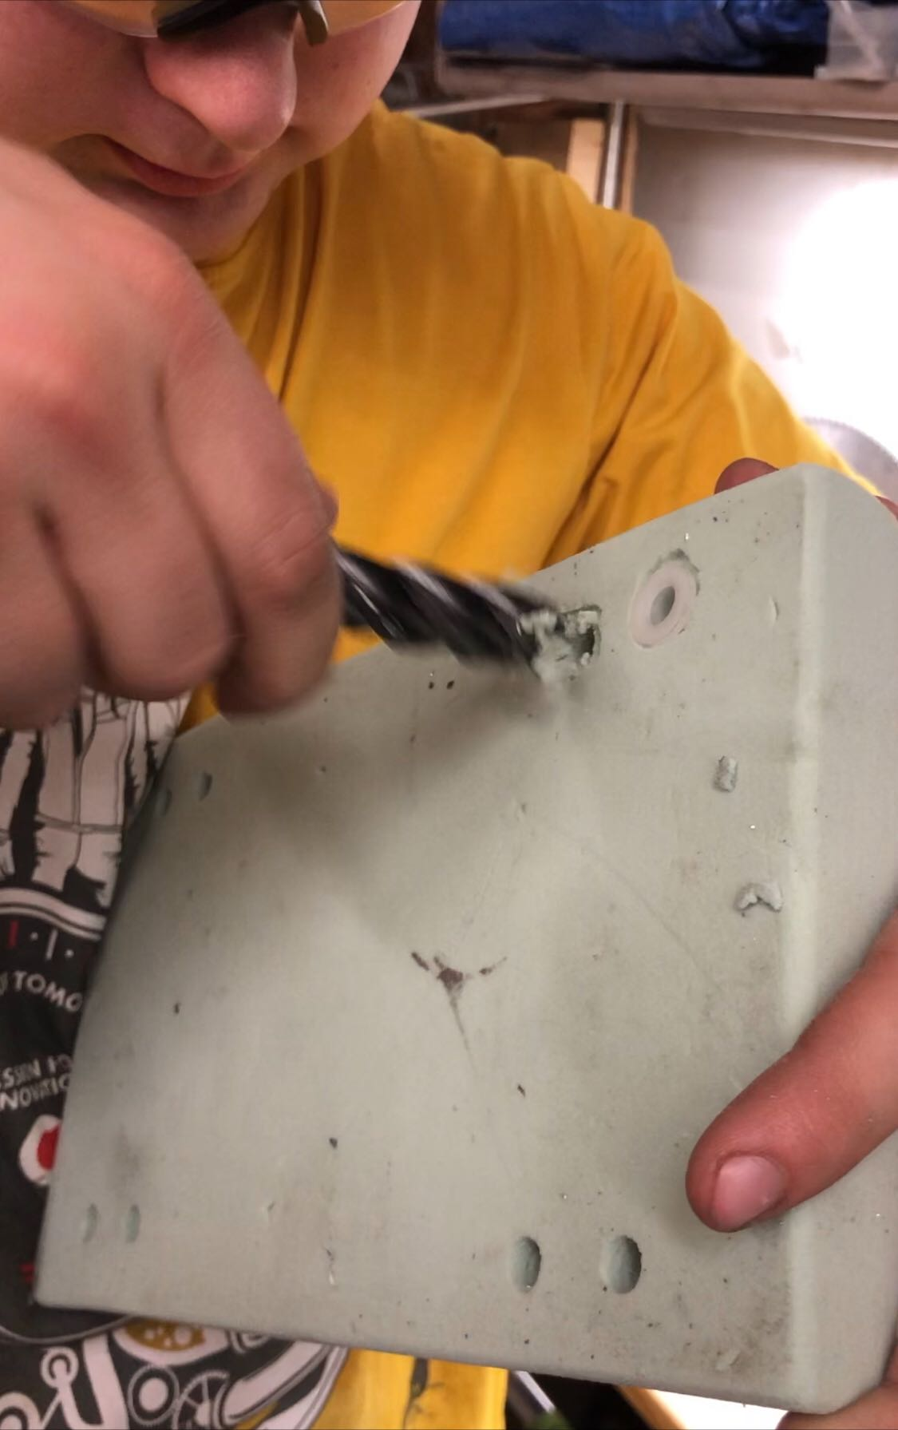
Progress
Waterjet – 100% (??)
Machining: ~85% complete
Welding: ~50% complete
Highlights
Rolling car ready

Slide 15
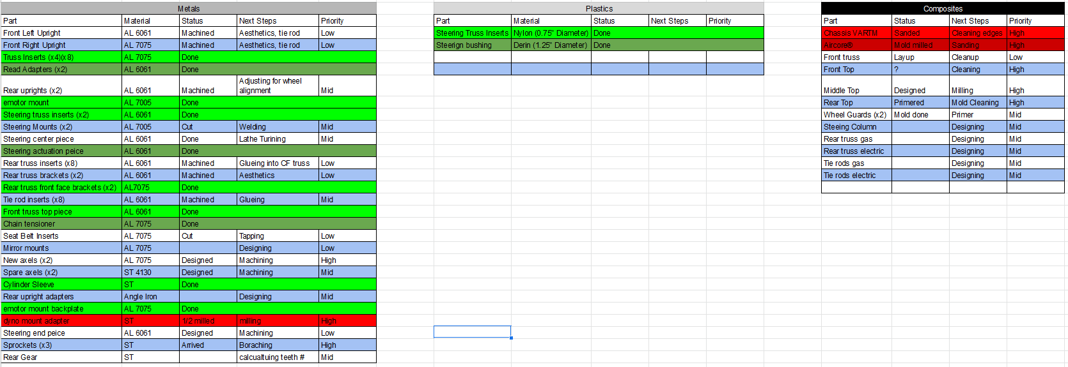
Manufacturing

Slide 16


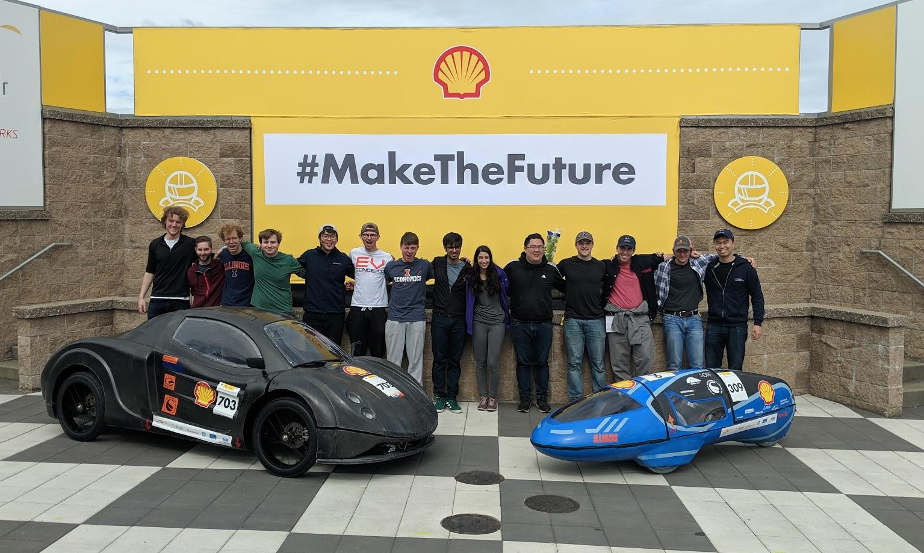


Slide 17
Administrative - Robert Mauge
Next year plan
Finish current EV2
Finalize EV3 design
Start manufacturing EV3
In tandem
Prepare for entering ESPL
Training on all aspects of team

Slide 18
Mechanical Team - Robert Mauge
Next year plan
Drive car as much as possible
Tests performed while driving
Stress testing of mechanical components
Overall efficiency
Acceleration under various conditions
Effect suspension has on efficiency and performance
Reuse current suspension
Redesign steering

Slide 19
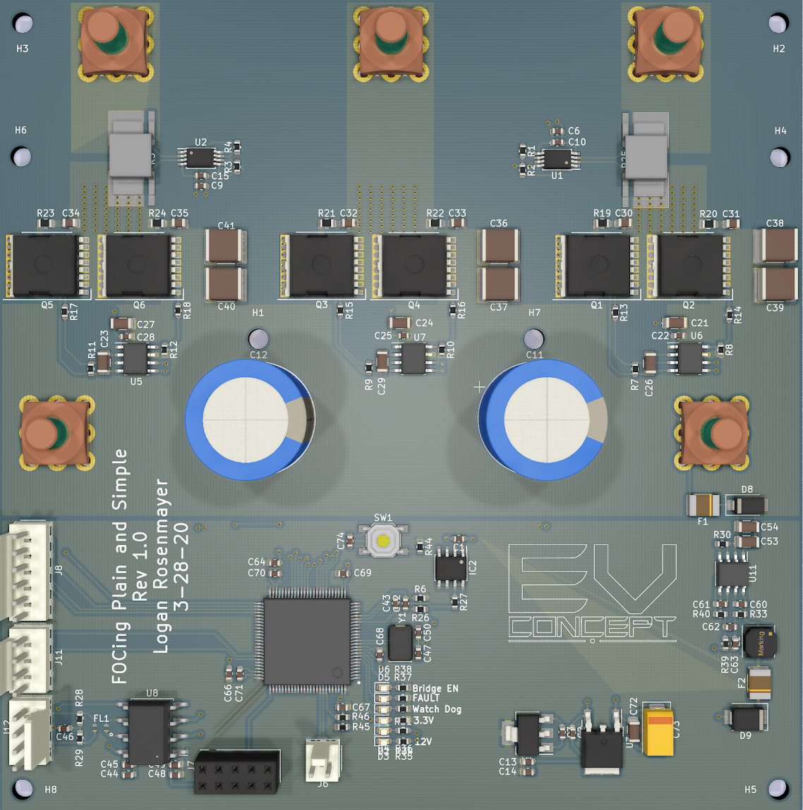
Electronics Team - Moving the Car
Redesigning the motor controller- Reduced cost by $40
Continuing redesign
Using STM32’s built in ADCs
H7 series has built in oversampling
Replaces most expensive part
Removed overkill linreg
Replacement is cheaper and easier to solder
Electronics meetings will be crash courses on critical topics for the team not taught in class
Zoom meetings that are recorded
Format: Premade slide decks
Covers concepts and math used in designing
Topics: Motor control, Li-Ion batteries, STM32 coding (2 lectures each)

Slide 20
Composites Team - Richard Mauge
Next year plan
Remake rear hood, front hood, rear license plate holder
Finalize design for EV3
Start machining exterior molds
Finish interior design with upholstery, climate controls
New steering wheel
Carbon fiber chair
Research into proper door latching, hinges, remote controlled door lock, etc.

Slide 21
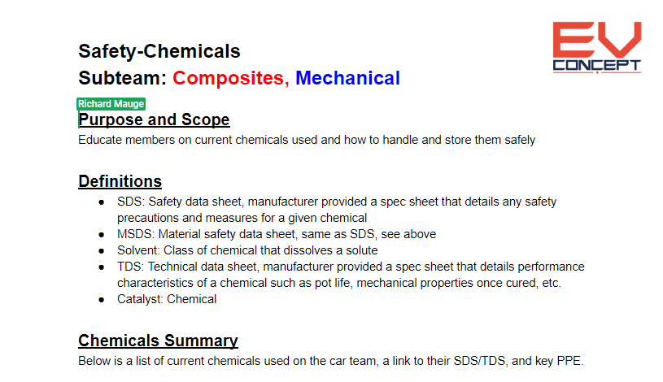
Composites/Mechanical Team
Documentation being made for all knowledge
On Google Drive, sorted by purpose (i.e. design, manufacturing, safety, technical, etc.)
Every documentation follows a strict outline, formatted to look professional
Links and pictures added to identify the tool/chemical being used, its SDS/TDS, etc.

